Slide 1








KICK OFF MEETING : EyeCloud HAMR
26th January 2022

Slide 2
Summary
Introduction
Target Architecture
RoadMap
1
2
3
4
5
6
Reminder of process
Functional Scope
Communication Plan

Slide 3
Introduction
Context & Stake
Kick off Purpose
Context
Build an active / active calculation platform on both datacenter aws Ireland and aws Canada.
Stake
Ongoing Support group strategy for having a central platform.
Continuously improving existing high availability solution with a minimum of downtime.
Confirm the project steps.
Confirm the assignation of dedicated resources.
Confirm the functional Scope and roadmap

Slide 4
Reminder of the process
Steps
Description
Actors
Deliveries
Business Overviews
Viet
Context Stake and Goals .
Expected Benefits / Success criteria's.
Desired deliveries dates and priorities
Viet / L.TCHAMFONG
Reviews J.Phillipe.
Resume context/stake and acceptance deliveries
Scoping / Requirements / Epics
Resp. Viet …
Perimeter , Scoping and hypotheses per components.
Define Matrix of components
Define technical's requirements ..
L.TCHAMFONG Viet J.NGUEN
Marc.B
JP. Lee
F.JEAN
-Scoping documents.
-Epics stories Details
Global Architecture Document
Resp. L.TCHAMFONG
Define scenarios for each steps
L.TCHAMFONG Viet J.NGUEN
Marc.B
JP. Lee
F.JEAN
Applications Designs
Charge / Resources Organizations
Resp. L.TCHAMFONG
Defined charge / charge plan based on the technical specifications and defined architecture
Define required resources
L.TCHAMFONG
M.BESANCENOT,
Y.FUCHS
C.ADINS
Costing components
Materials resources
Assigns human resources
Direction / Planning
Resp .Viet
Define direction / lots
detailed project plan .
L.TCHAMFONG
Reviews: Viet
Direction + Project plan
Implementation /Realization
Resp. L. TCHAMFONG
Enhancement on impacted components.
RIDE (Rashmi)
RIOS (Jean paul)
RICS (K.GLA)
CCOE (Souad/Chunan)
Setup
Change Management
Resp. Viet
Define change management strategy and operational training plan
Viet
Change management plan

Slide 5
Functional Scope
Eyecloud V2
with the current Architecture
Eyecloud V3 with the new architecture
Multiple ID Types (UEID, ULID,UFID, UOID) with the V2
Unique ID Type with the V3 and uniqueness reinforcement
Current Users are using V2
Current and new Users will use V3 to get and create new IDs
Today
Tomorrow

Slide 6
How Eyecloud works : Simplified Architecture
Orchestra
ESO
BBGR
DEO
A&R
Orchestra
ESO
BBGR
DEO
Orchestra
ESO
BBGR
R53
Get ECID
Post data/document
Get data/document
ALB int
ALB ext
Provides of unique ECID on the fly | batch mode
Stores (POST) document / metadata
Provides (GET) document / metadata
Authentication Authorization
MySQL
Dynamo DB
S3

Slide 7
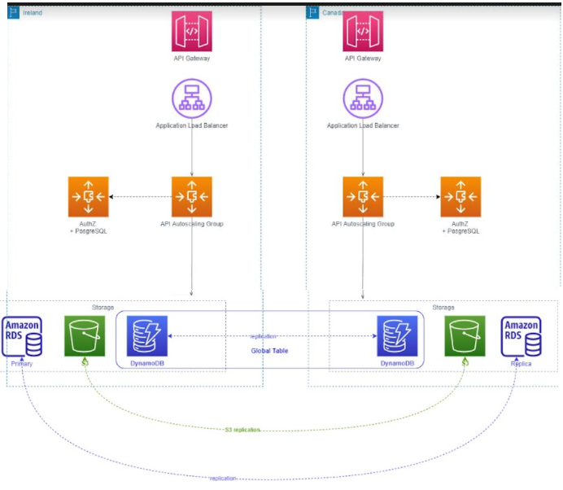
Setting an High Availability Multi Region (HAMR) API on AWS

Slide 8
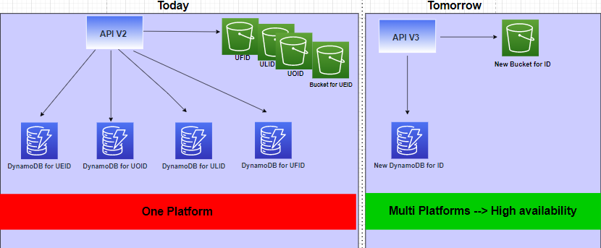
Difference between V2 and V3 : Infrastructure
 | V2 | V3
URL | https://in-eyecloud.rxdigitalplatform.com/v2/uoid | https://in-ec-prd.rxdigitalplatform.com/v3/ecid
Eyecloud ID Format | Alphanumeric with 8 Characters | Alphanumeric with 9 characters
 | Lowercase only | Lower case only

Slide 9
2021 |  | 2022
November | December | Q1 | Q2 | Q3 | Q4
Scoping STEP
Conception and Realization STEP 1
Route 53
Scoping / Requirements
ASGs duplication
S3 Replication
Global table in Dynamo DBs
I
Id uniqueness enhancement
Discussion with users
Realization
Conception and Realization STEP 2
Authentication
Authorization

Slide 10
Communication Plan
Meeting Type
Steerco Meeting with management team
Follow Up meeting with project team
When
Once a month
Once a week
Lionel
Viet
Jean Philippe
Marc
Christophe
Yoann
Lionel
Rashmi
Souad
Chunan
K.GLA
Jean Paul
Françoise
Who

